Slide 1



Presentation on
PHISHING ATTACK
By :
SHASHANK SS

Slide 2
Contents
02
Introduction
﻿What is phishing attack
Typical Scenario of phishing
﻿History of phishing attack
Types of phishing attack & it's example
Phishing statistics in india
Prevention from phishing attack
﻿Anti-phishing software
Punishment & Cyber law
Conclusion
Reference

Slide 3
03
Introduction
Phishing is a type of social engineering attack often used to steal user data, including login credentials and credit card numbers.

Slide 4

04
What is Phishing?
The term Phishing can be defined as an act of attempting to acquire sensitive information by pretending to be a trustworthy entity.

Slide 5
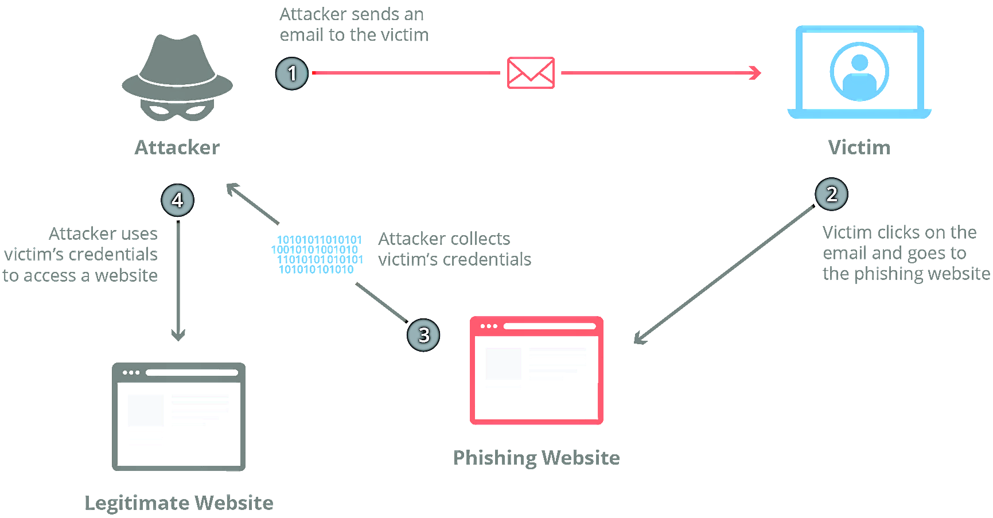

Typical Scenario of Phishing Attacks
05

Slide 6
History of Phishing Attack
07
1990
2008
2019
The first phishing attempt is recorded on America online (AOL). Hacker attempt to steal login credentials & personal information from AOL to resell online.
Bitcoin & crypto currency are launched this increases the creation of malware as it is easier for cyber criminals to securely receive payment from their victims
Cyber criminals begin hiding malicious code inside image files to slip through user's anti-virus software
Th riseof E-commerce encourages cyber criminals to create spoofed websites, impersonating popular domain like ebay & PayPal.
Phishing becomes the primary technique to deliver ransomware
2000
2013

Slide 7




08
Types of Phishing Attacks
EMAIL PHISHING
CLONE PHISHING
SPEAR PHISHING
VOICE PHISHING

Slide 8
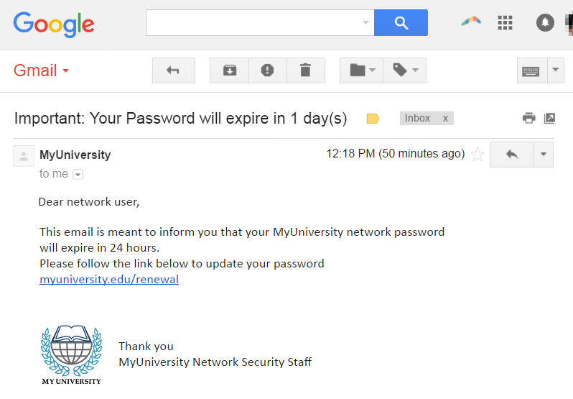
01
09
Email Phishing & it's Example
The most widely known form of phishing, this attack is an attempt to steal sensitive information via an email that appears to be from a legitimate organization.

Slide 9
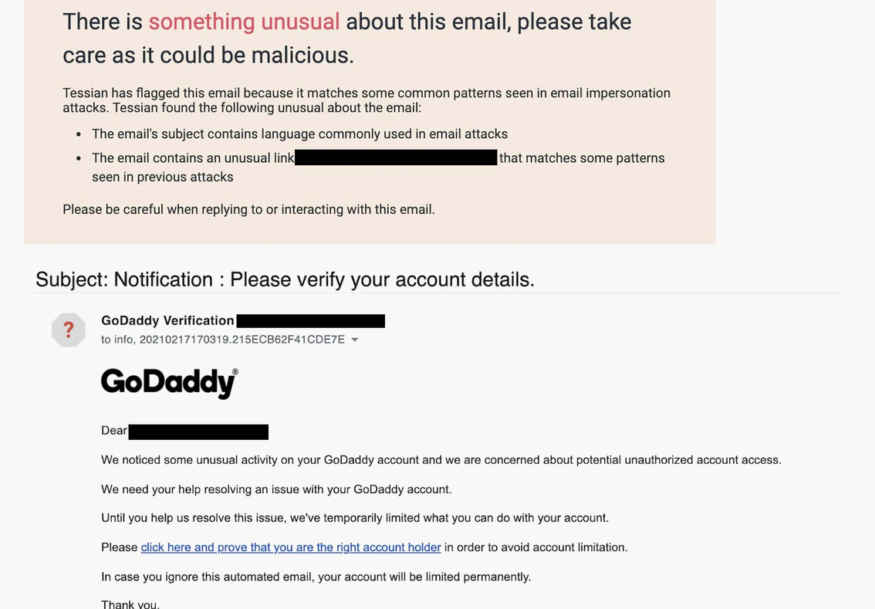
02
10
Spear Phishing & it's Example
These email messages are sent to specific people within an organization, usually high-privilege

Slide 10
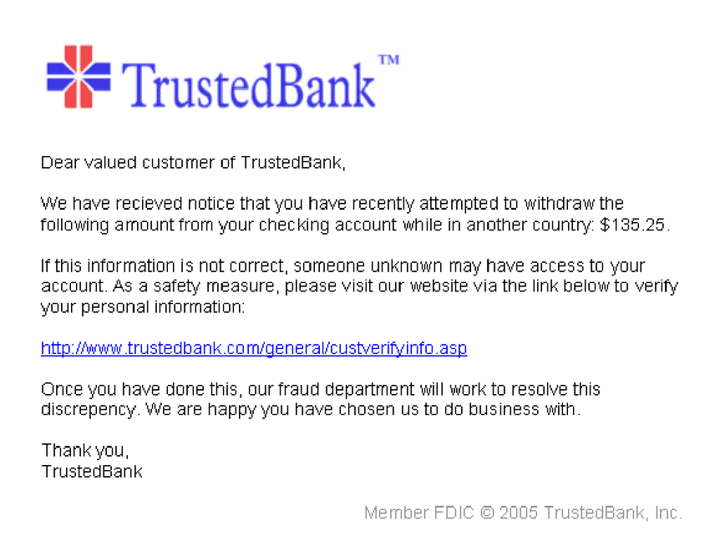
03
11
Clone Phishing & it's Example
In this type of phishing, the attacker clones a genuine or legitimate email that you might have received from an authentic sender but sent from a spoofed email id

Slide 11
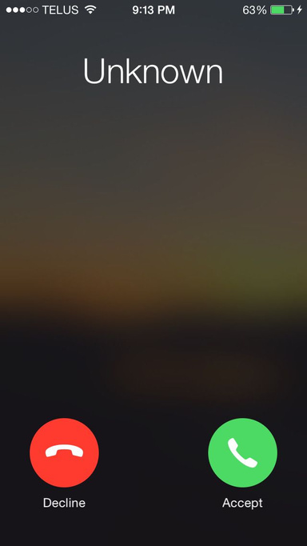
04
12
Voice Phishing & it's Example
Vishing—or voice phishing—is the use of fraudulent phone calls to trick people into giving money or revealing personal information.

Slide 12
PHISHING ATTACK STATISTICS IN INDIA
2012
2013
Around 83% of IT teams in Indian organizations said the number of phishing emails targeting their employees increased during 2020
2014
83%
2015
2016
2017
2018
2019
2020
0
20,000
40,000
60,000
Number of cyber crimes reported across India
13

Slide 13
PHISHING ATTACK STATISTICS IN INDIA
Other
8%
During the first quarter of 2021, 24.9% of phishing attacks worldwide were directed towards financial institution
On top of that, social media accounted for 23.6 percent of attacks making these two the highest targeted industries when it came to phishing during this period.
Logistics and shipping
5.8%
Financial Institution
24.7%
E-commerce
7.6%
Payment
8.5%
Socila Media
23.7%
SaaS
19.7%
Most targeted industry in India, first quarter of 2021
14

Slide 14
PREVENTIONS FROM PHISHING ATTACK
Know what a phishing scam look like
Don't click on that link
Don't give your information to unsecured site
﻿Rotate your password regularly
﻿Install Firewalls
﻿Install Anti-phishing software
15

Slide 15
ANTI-PHISHING SOFTWARE
01
Area 1 Horizon
Cloud based service that offer protection from phishing on Email & network based vectors
02
GreatHorn
This cloud- native email security service protect from phishing attack on office 365, email carrying ransomware
03
IronScale
This is a self learning email security platform powered by AI. It can help you to detect & predict phishing attacks.
16

Slide 16

PUNISHMENT AND CYBER LAW
Hacking into a computer network, data theft, introducing and spreading viruses through computer networks, This is a punishable offence under Section 43 of the Information Technology Act, 2000 with the maximum punishment for the above offences is imprisonment of up to 3 years or a fine or Rs. 5,00,000 (Rupees five lac) or both.
17

Slide 17

CONCLUSION
No single technology will completely stop Phishing Attacks.
However a combination of good organization and practice, proper application of current technologies and improvement in security technology has the potential to drastically reduce the prevalence of phishing and the losses suffered from it.
18

Slide 18


REFERENCE
Books
Phishing Exposed
﻿Social engineering
Phishing Attacks
Websites
www.phishing.org
19

Slide 19
Thank You
20

